Slide 1

Introduction to Machine Learning Topic 7 – Dimensionality reduction (HOML Ch. 8 / ISL Ch.10)
Master in Quantitative Economic Analysis MQuEA
Javier Bas
Universidad Autónoma de Madrid
2022/2023

Slide 2
Outline
Dimensionality reduction
Curse of dimensionality
Projection and Manifold
Principal Component Analysis (PCA)
Kernel Principal Component Analysis
Other dimensionality reduction techniques
Master in Quantitative Economic Analysis MQuEA
Universidad Autónoma de Madrid

Slide 3
Dimensionality Reduction
It is common to count with datasets with hundreds (or even thousands) of features
This makes training super slow, but also incurs in the so-called Curse of dimensionality, which can be understood in several ways:
The ratio between observations and features may be too small, meaning lots of features for just ‘a few’ observations. Thus, the more dimensions, the more overfitting
In high-dimensional datasets it is more probable that the observations are ‘far away’ from each other, because they can differ in more aspects (data become sparse). Therefore, it will be difficult to predict new instances because any new instance will be far away from an already known (training) one
One solution could be to increase the size of the dataset. But we quickly realize that the number of instances required to reach a given density grows exponentially with the number of dimensions
Master in Quantitative Economic Analysis MQuEA
Universidad Autónoma de Madrid

Slide 4
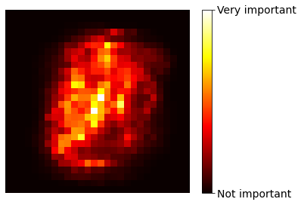
Dimensionality Reduction
Considering the MNIST dataset:
Pixels on the image borders are not relevant because they usually are white
Two neighbor pixels are often high correlated, we could merge them into a single one (taking the mean, for instance)
Therefore, all training instances may lie within a much lower-dimensional subspace of the high-dimensional space, within loosing much information.
Master in Quantitative Economic Analysis MQuEA
Universidad Autónoma de Madrid

Slide 5
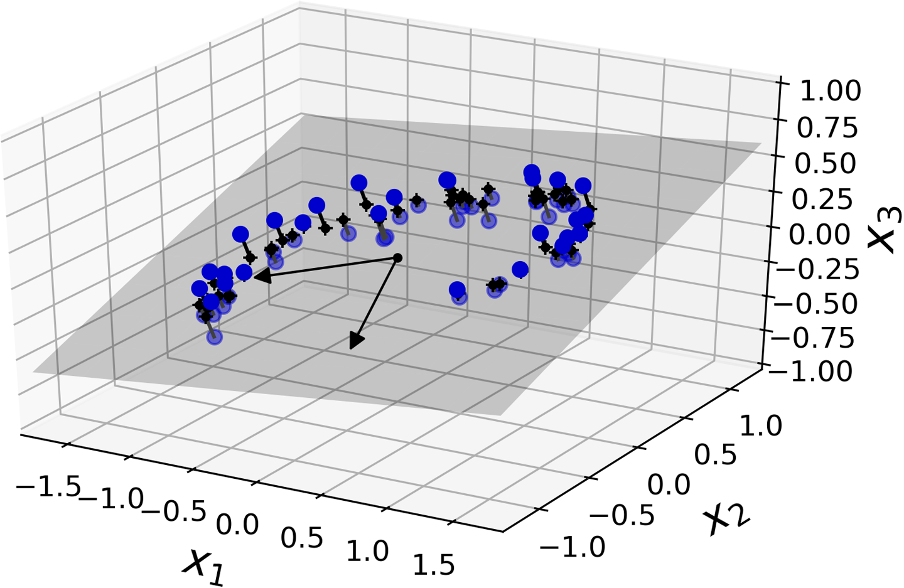
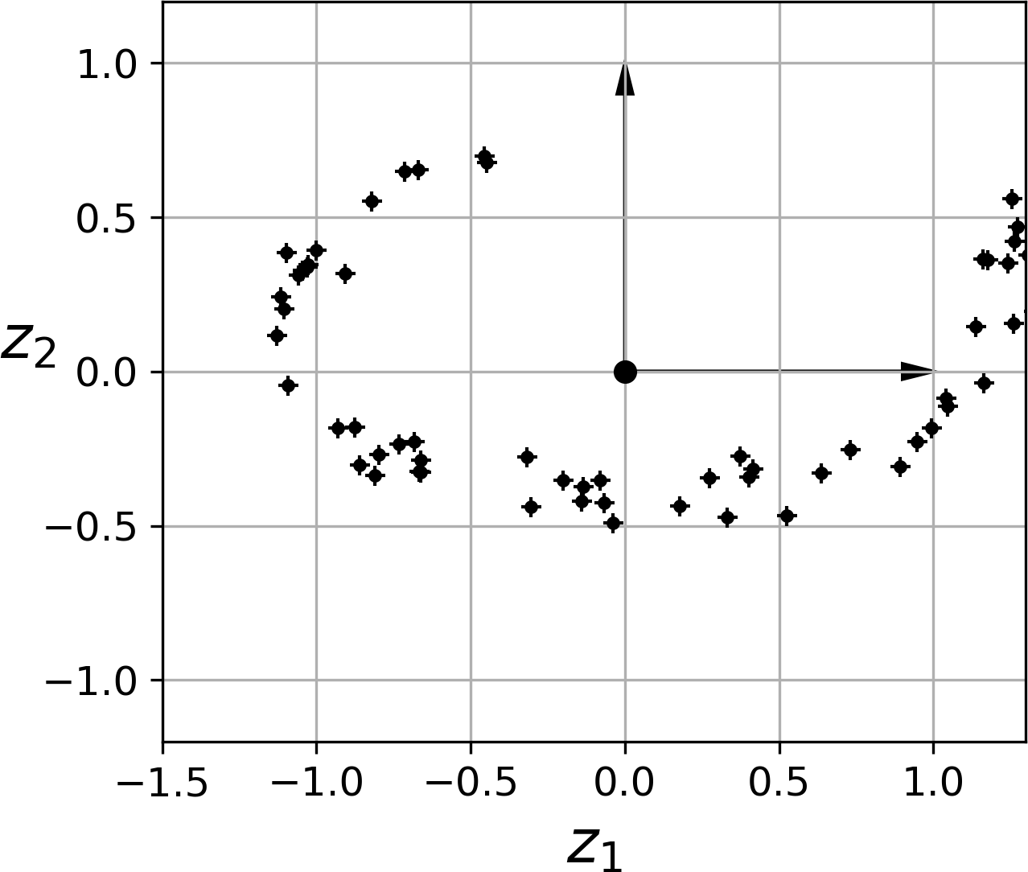
Dimensionality Reduction
Projection (drop one dimension)
all instances seem to lie close to a plane
Master in Quantitative Economic Analysis MQuEA
Universidad Autónoma de Madrid

Slide 6
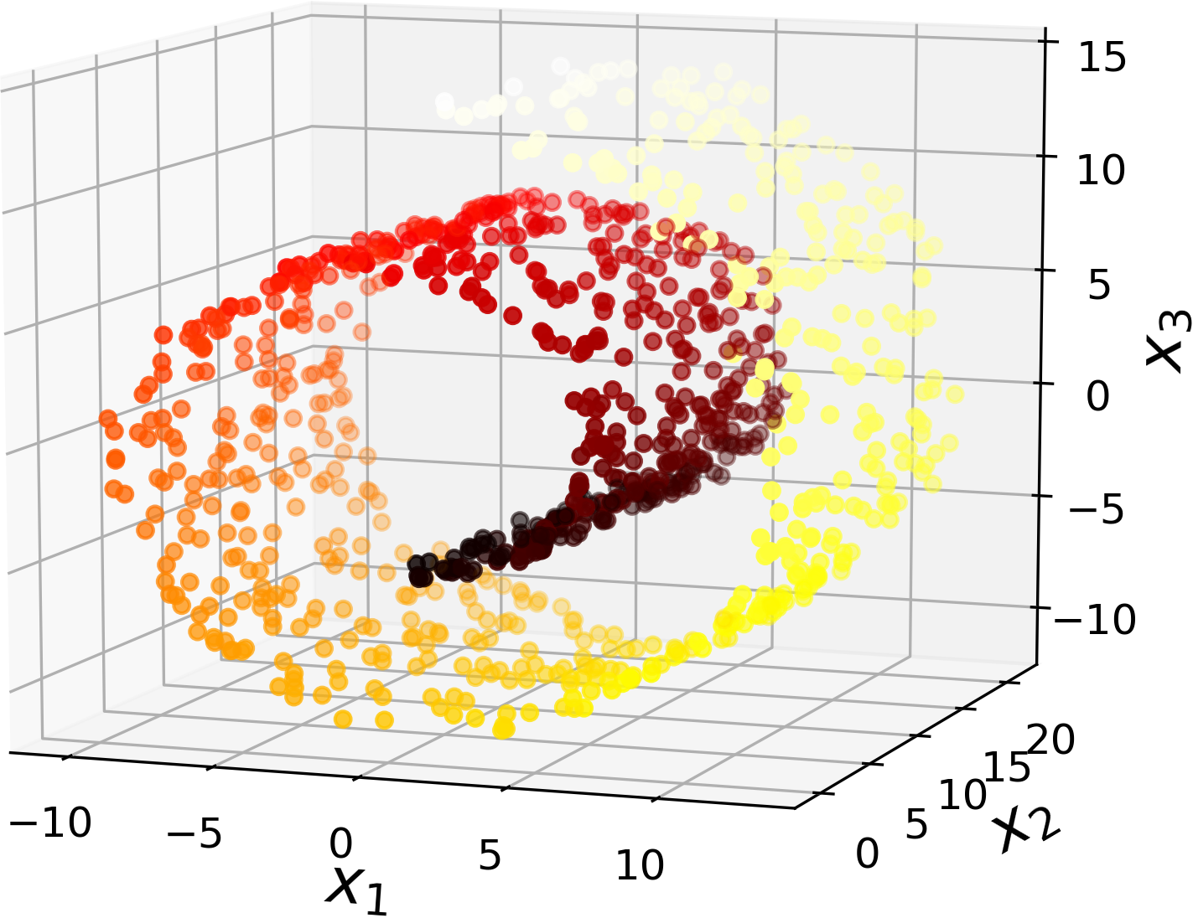
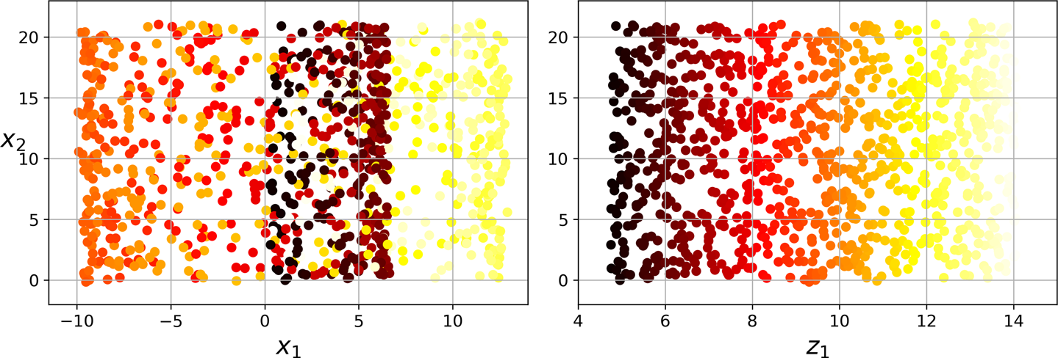
Dimensionality Reduction
Manifold (unroll the dataset)
the subspace seems to twist/turn
Master in Quantitative Economic Analysis MQuEA
Universidad Autónoma de Madrid

Slide 7
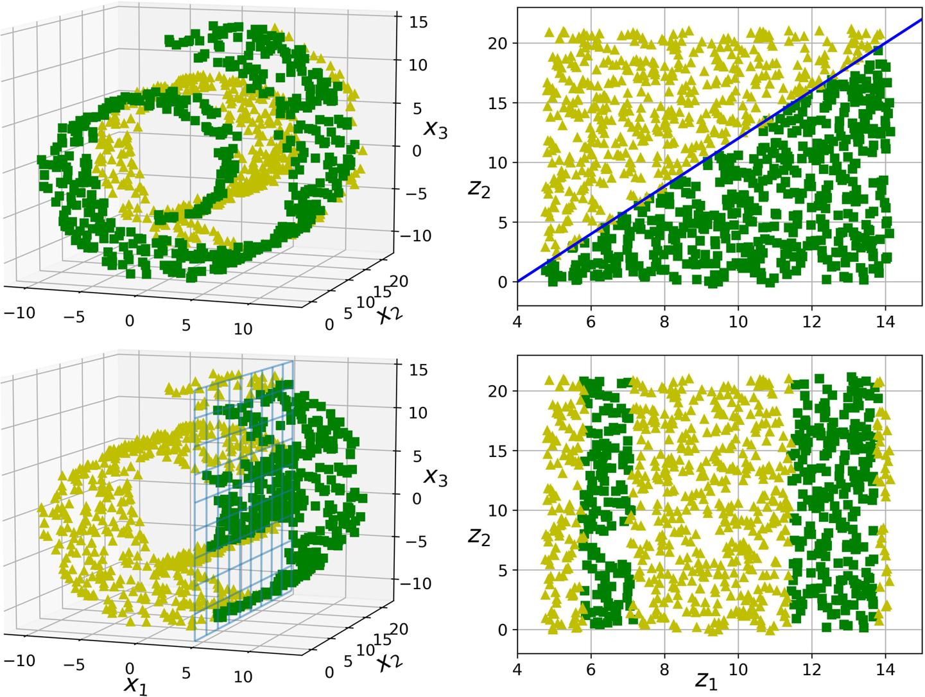
Dimensionality Reduction
Lots of high-dimensional datasets lie close to a much lower-dimensional manifold (this is the manifold hypothesis). Which is equivalent to say that a problem can be better explained in lower dimensions. But that might not be always the case, of course.
Master in Quantitative Economic Analysis MQuEA
Universidad Autónoma de Madrid

Slide 8
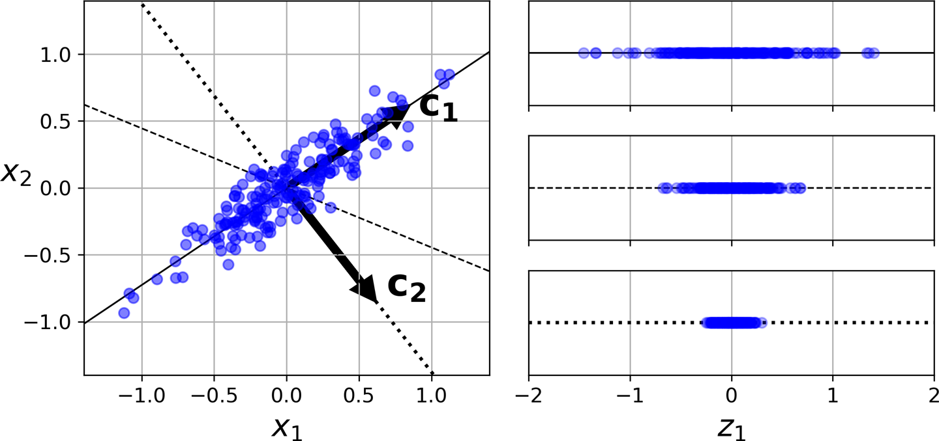
Principal Component Analysis (PCA)
In a nutshell, PCA identifies a hyperplane that lies closest to the data, and then projects the data onto it
How to select the best hyperplane? The one that keeps the highest variance in the data (or minimizes the mean squared distance between the actual data and its projection)
Master in Quantitative Economic Analysis MQuEA
Universidad Autónoma de Madrid

Slide 9
Principal Component Analysis (PCA)
More formally, the principal component directions are directions in the feature space along which the original data are highly variable. They also define lines and subspaces that are as close as possible to the data cloud
Principal Component Analysis refers to the process by which principal components are computed
PCA is an unsupervised method since it only involves the features, making no use of the response
PCA is also a tool for data visualization since makes possible to plot in 2D or 3D much higher-dimensional information
Master in Quantitative Economic Analysis MQuEA
Universidad Autónoma de Madrid

Slide 10
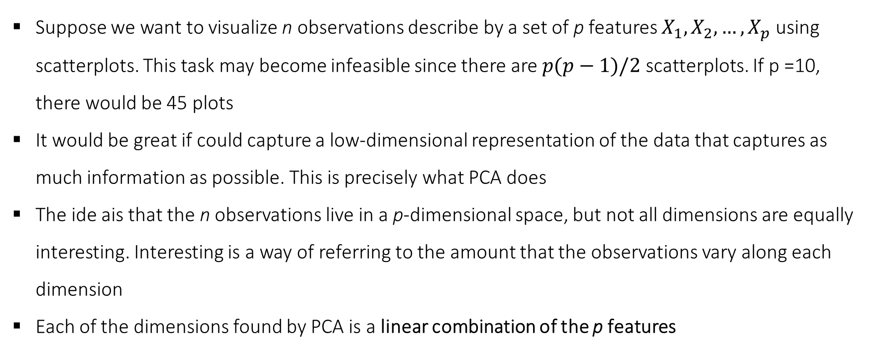
Principal Component Analysis (PCA)
Suppose we want to visualize n observations describe by a set of p features $X_{1},X_{2},…,X_{p}$ using scatterplots. This task may become infeasible since there are $p(p−1)/2$ scatterplots. If p =10, there would be 45 plots
It would be great if could capture a low-dimensional representation of the data that captures as much information as possible. This is precisely what PCA does
The ide ais that the n observations live in a p-dimensional space, but not all dimensions are equally interesting. Interesting is a way of referring to the amount that the observations vary along each dimension
Each of the dimensions found by PCA is a linear combination of the p features
Master in Quantitative Economic Analysis MQuEA
Universidad Autónoma de Madrid

Slide 11
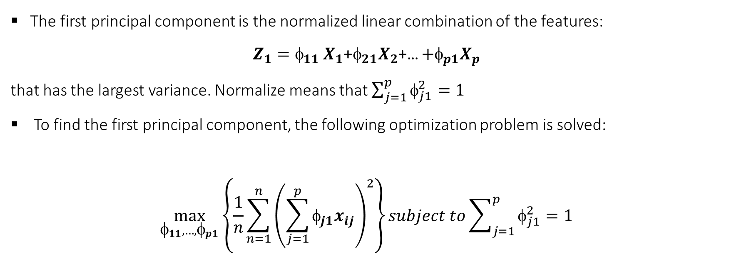
Principal Component Analysis (PCA)
The first principal component is the normalized linear combination of the features:
$Z_{1}=_{11}$ $X_{1}$+$_{21}X_{2}$+… ${+}_{p1}X_{p}$
that has the largest variance. Normalize means that $\sum_{j=1}^{p}{φ_{j1}^{2}=1}$
To find the first principal component, the following optimization problem is solved:
$$\max_{φ_{11},…,φ_{p1}}\left\{\frac{1}{n}\sum_{n=1}^{n}{{\left(\sum_{j=1}^{p}{φ_{j1}x_{ij}}\right)}^{2}}\right\}subject to\sum_{j=1}^{p}{φ_{j1}^{2}=1}$$
Master in Quantitative Economic Analysis MQuEA
Universidad Autónoma de Madrid

Slide 12
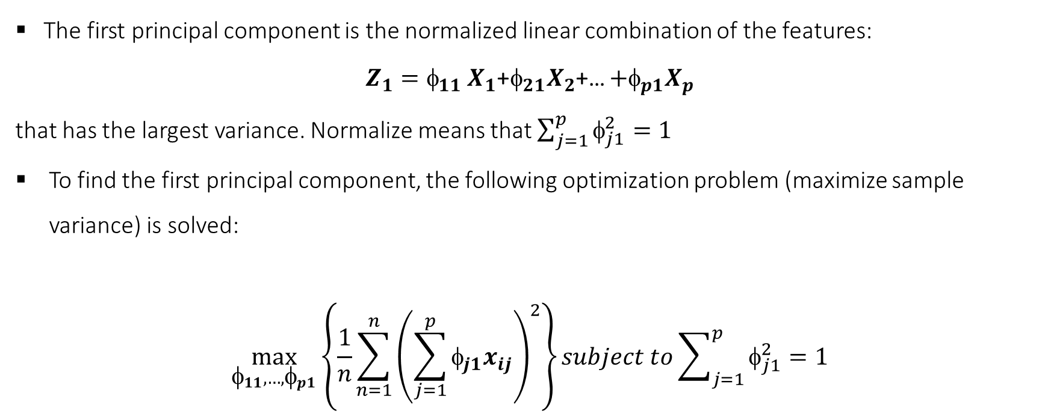
Principal Component Analysis (PCA)
The first principal component is the normalized linear combination of the features:
$Z_{1}=_{11}$ $X_{1}$+$_{21}X_{2}$+… ${+}_{p1}X_{p}$
that has the largest variance. Normalize means that $\sum_{j=1}^{p}{φ_{j1}^{2}=1}$
To find the first principal component, the following optimization problem (maximize sample variance) is solved:
$$\max_{φ_{11},…,φ_{p1}}\left\{\frac{1}{n}\sum_{n=1}^{n}{{\left(\sum_{j=1}^{p}{φ_{j1}x_{ij}}\right)}^{2}}\right\}subject to\sum_{j=1}^{p}{φ_{j1}^{2}=1}$$
Master in Quantitative Economic Analysis MQuEA
Universidad Autónoma de Madrid

Slide 13
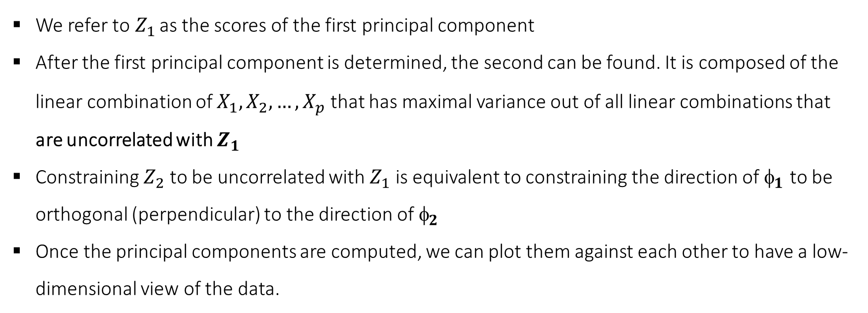
Principal Component Analysis (PCA)
We refer to$Z_{1}$ as the scores of the first principal component
After the first principal component is determined, the second can be found. It is composed of the linear combination of $X_{1},X_{2},…,X_{p}$ that has maximal variance out of all linear combinations that are uncorrelated with $Z_{1}$
Constraining $Z_{2}$ to be uncorrelated with $Z_{1}$ is equivalent to constraining the direction of $_{1}$ to be orthogonal (perpendicular) to the direction of $_{2}$
Once the principal components are computed, we can plot them against each other to have a low-dimensional view of the data.
Master in Quantitative Economic Analysis MQuEA
Universidad Autónoma de Madrid

Slide 14
Principal Component Analysis (PCA)
Master in Quantitative Economic Analysis MQuEA
Universidad Autónoma de Madrid

Slide 15
Principal Component Analysis (PCA)
It is important to scale each variable individually before computing PCA
Each vector (loading vector) composing the principal component is unique
A question that follows naturally is… How much information is lost by projecting the observations onto the first few principal components?
We are interested in knowing the proportion of variance explained (PVE) by each principal component (al PVEs sum up to 1).
Master in Quantitative Economic Analysis MQuEA
Universidad Autónoma de Madrid

Slide 16
Principal Component Analysis (PCA)
scree plot
elbow
Master in Quantitative Economic Analysis MQuEA
Universidad Autónoma de Madrid

